Slide 1
NameSpace

Slide 2
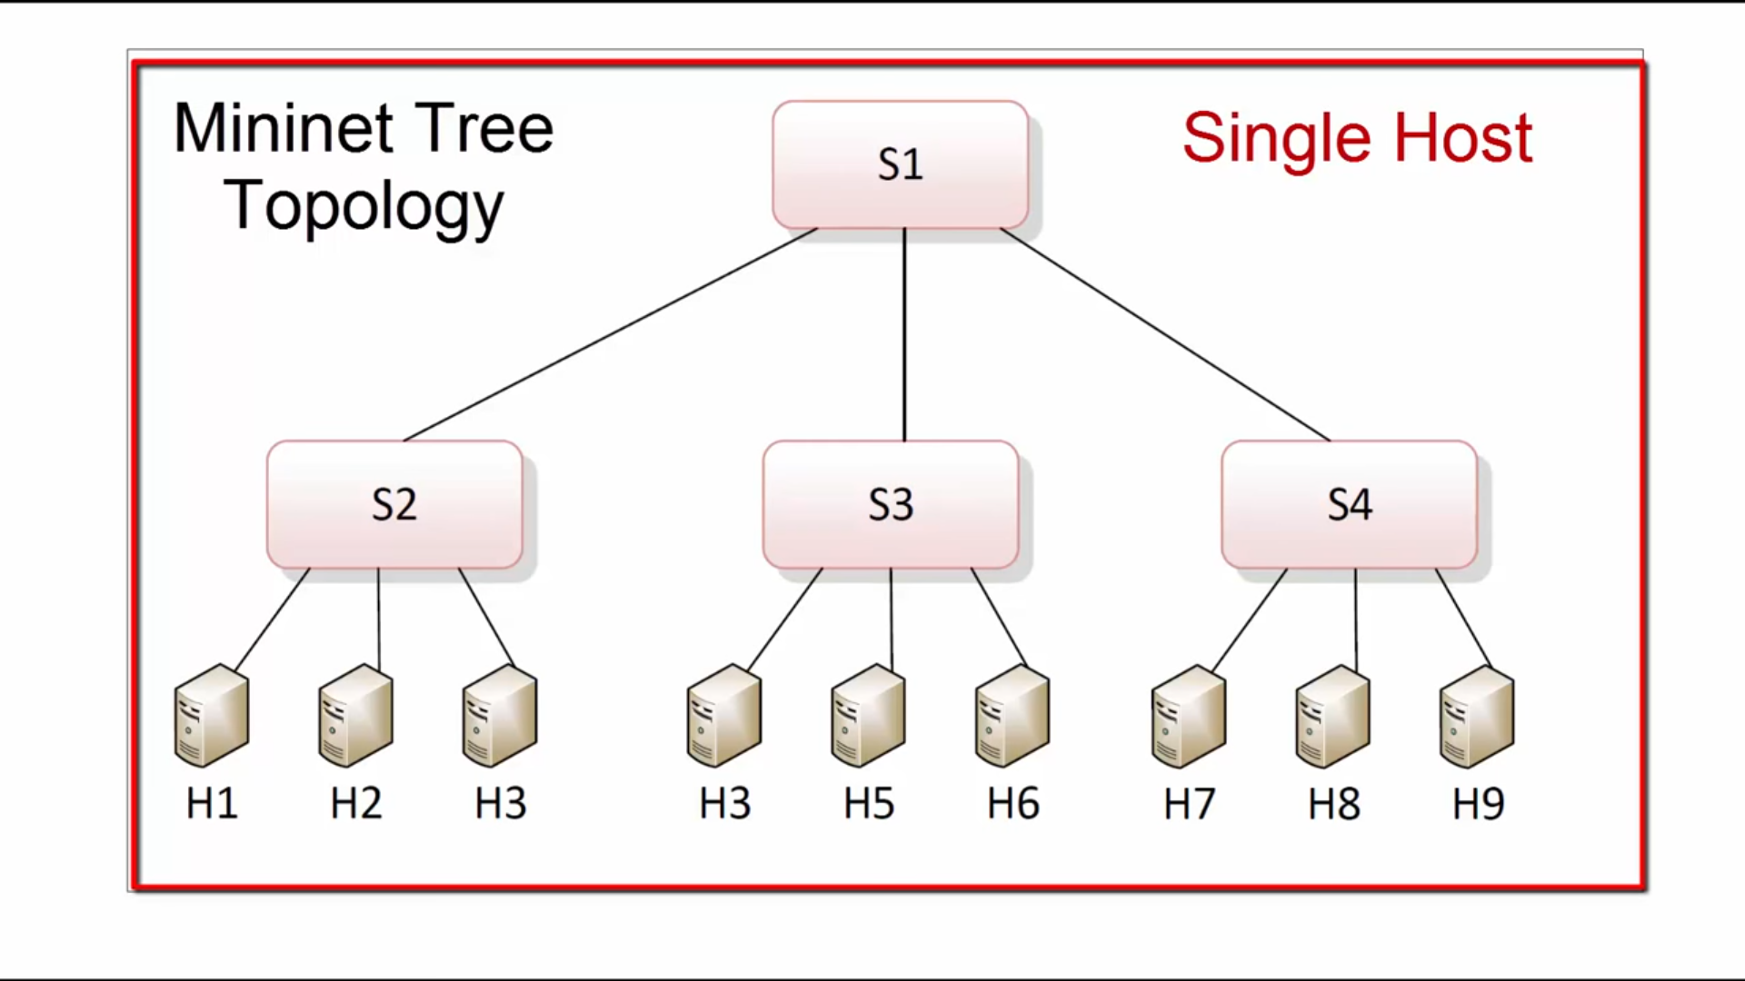
NEED OF NAMESPACE
Multiple isolated networking environment running on single machine
Each NS has it’s own interface,routing table,and forwording table
Mininet is allow you to launch custom virtual network topology in single machine.

Slide 3
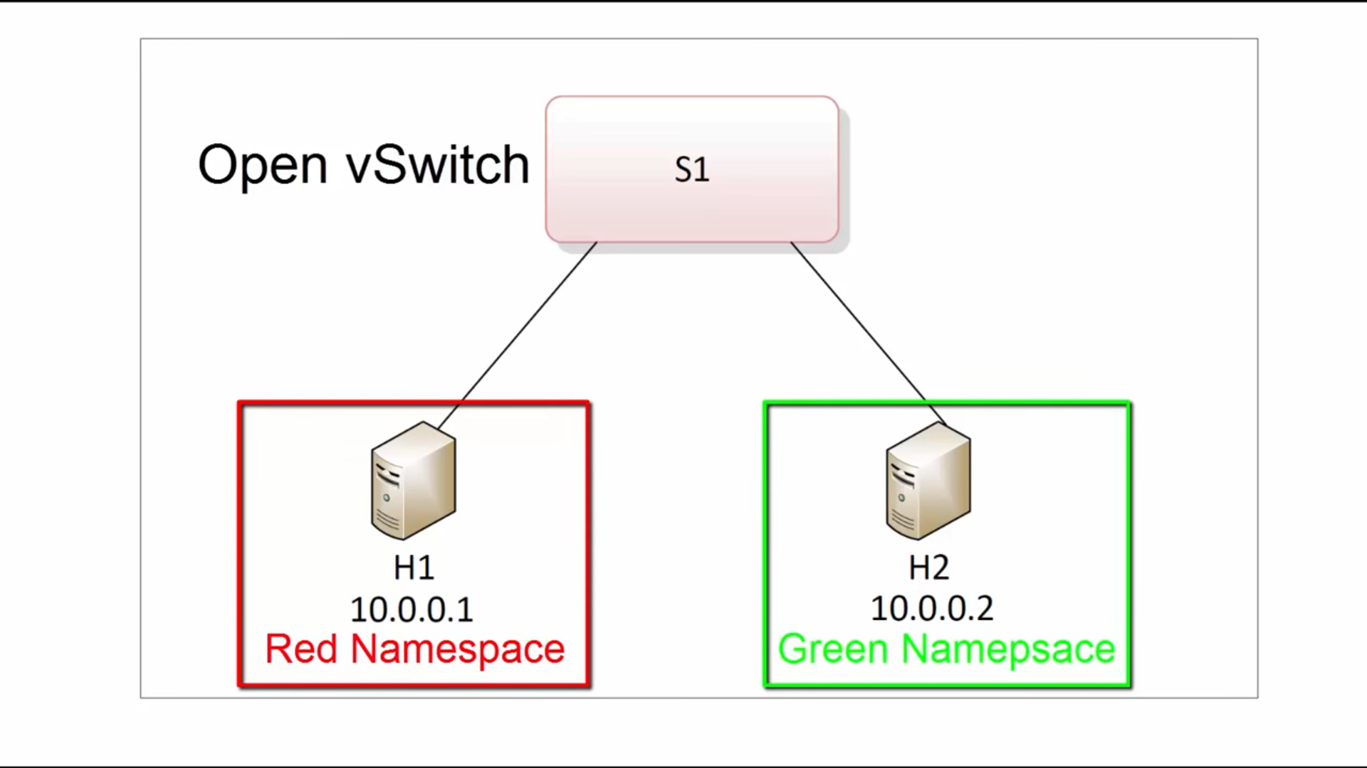
ENVIROMENT
This is the environment which we are going to create for learning.

Slide 4
ENVIROMENT
This is the environment which we are going to create for learning.

Slide 5
Root network namespaces
Root network namespace is default one when you are going to work on Linux system .
Ip a or ip addr show detail of nic card’sand ip’s
Ip route shows routing table
------------------------------------------------------
# Ip netns -. To see all namespaces
NOTE:- some time we don’t have ns software installed in os so follow below steps
# yum install iproute*netns*
Now we are going to create two namespace
Ip netns add red
Ip netns add green
Ip netns list
Or ip netns del red -> to delete red NS

Slide 6
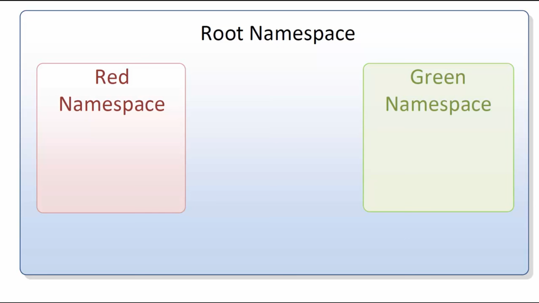
NOW WE NEED TO CONNECT ALL TOGETHER
RED AND GREEN ARE ISOLATED FROM EACH OTHER EVEN FROM ROOT NS

Slide 7

NOW WE HAVE
RED and GREEN NS are isolated to each other and from root name space
NOW WORK UNDER NS
-> ip netns exec red ip link => with this cmd we simply execute ip link command in RED NS.
Now we only have lo interface in RED NS
NOW create brdge either from brctl or OVS I’m using brctl
#Brctl addbr OVS1

Slide 8
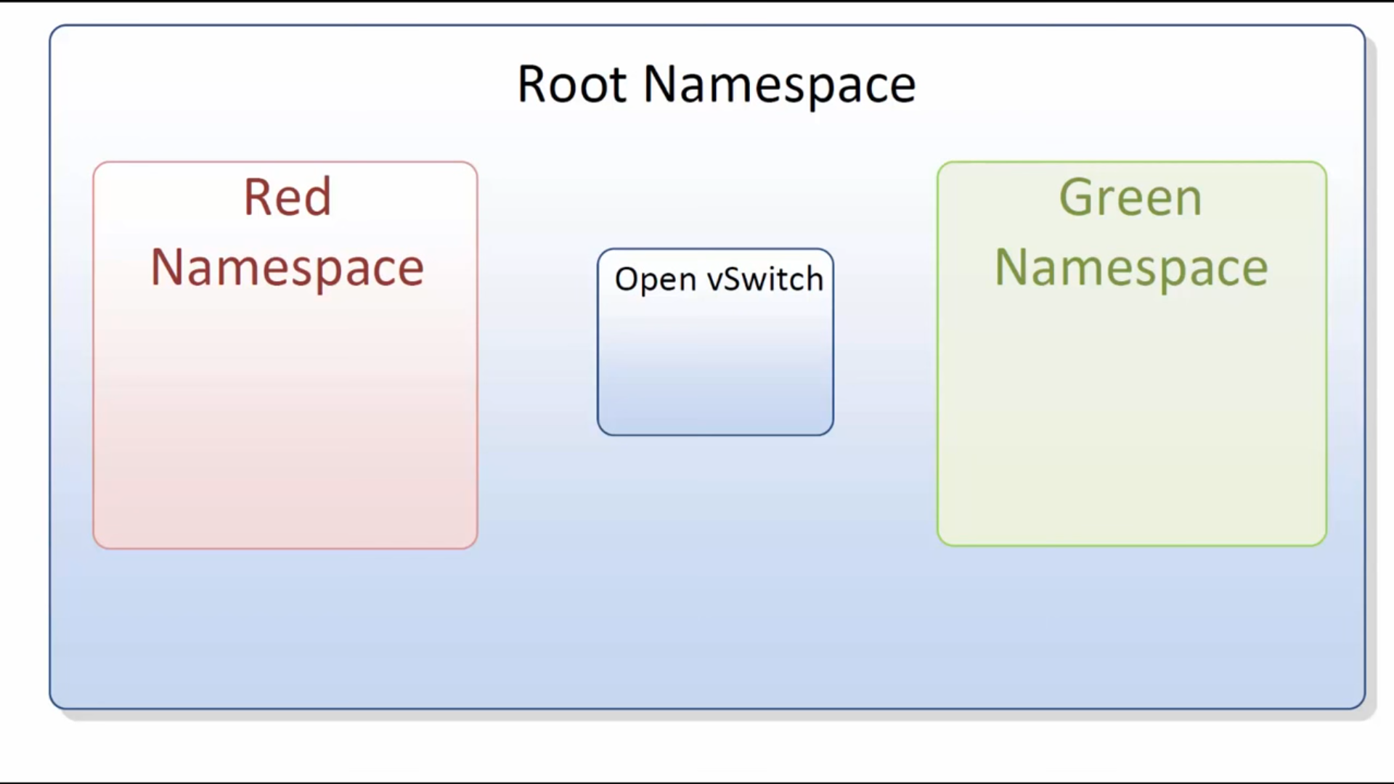
NOW WE NEED TO CONNECT ALL TOGETHER
RED AND GREEN ARE ISOLATED FROM EACH OTHER EVEN FROM ROOT NS

Slide 9
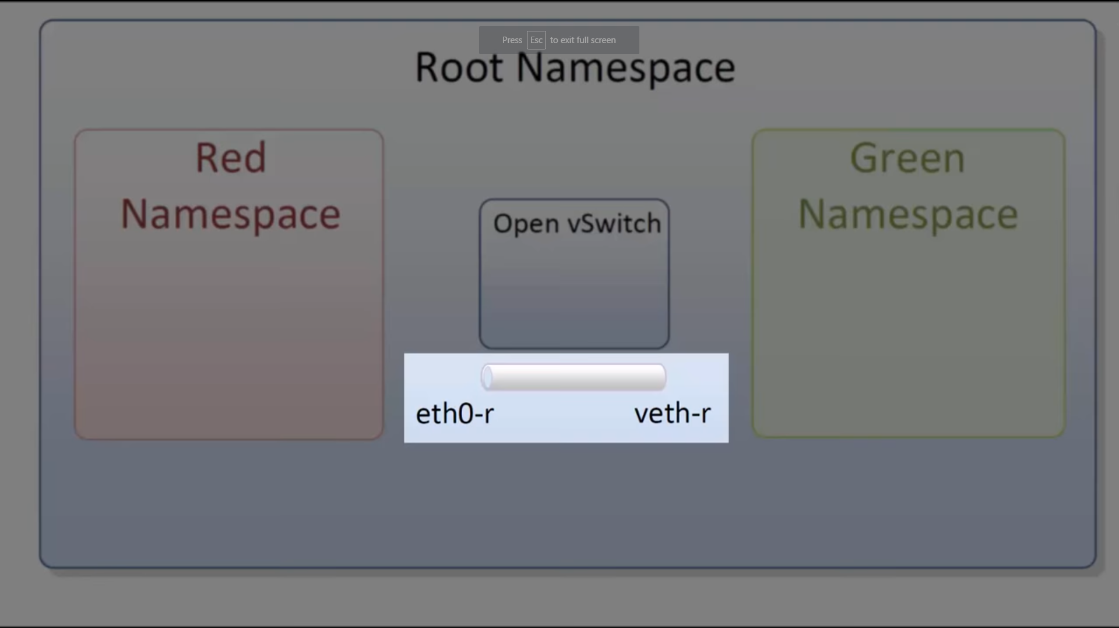
NOW create a veth to connect RED NS with OVS BRIDGE

Slide 10
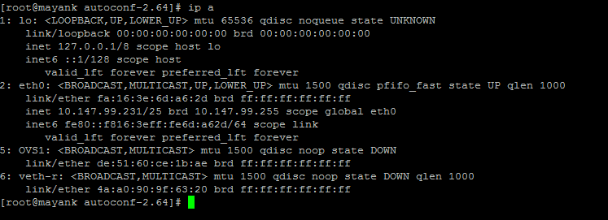
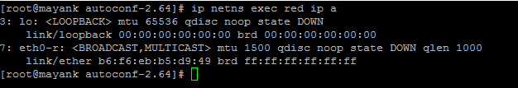
NOW create a veth to connect RED NS with OVS BRIDGE
AFTER EXECUTE OF THIS CMD YOU’LL NOW SEE eth0-r in ip a command

Slide 11
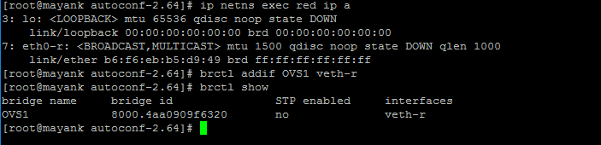
NOW create a veth to connect RED NS with OVS BRIDGE
AFTER EXECUTE OF THIS CMD YOU’LL NOW SEE eth0-r in ip a command

Slide 12
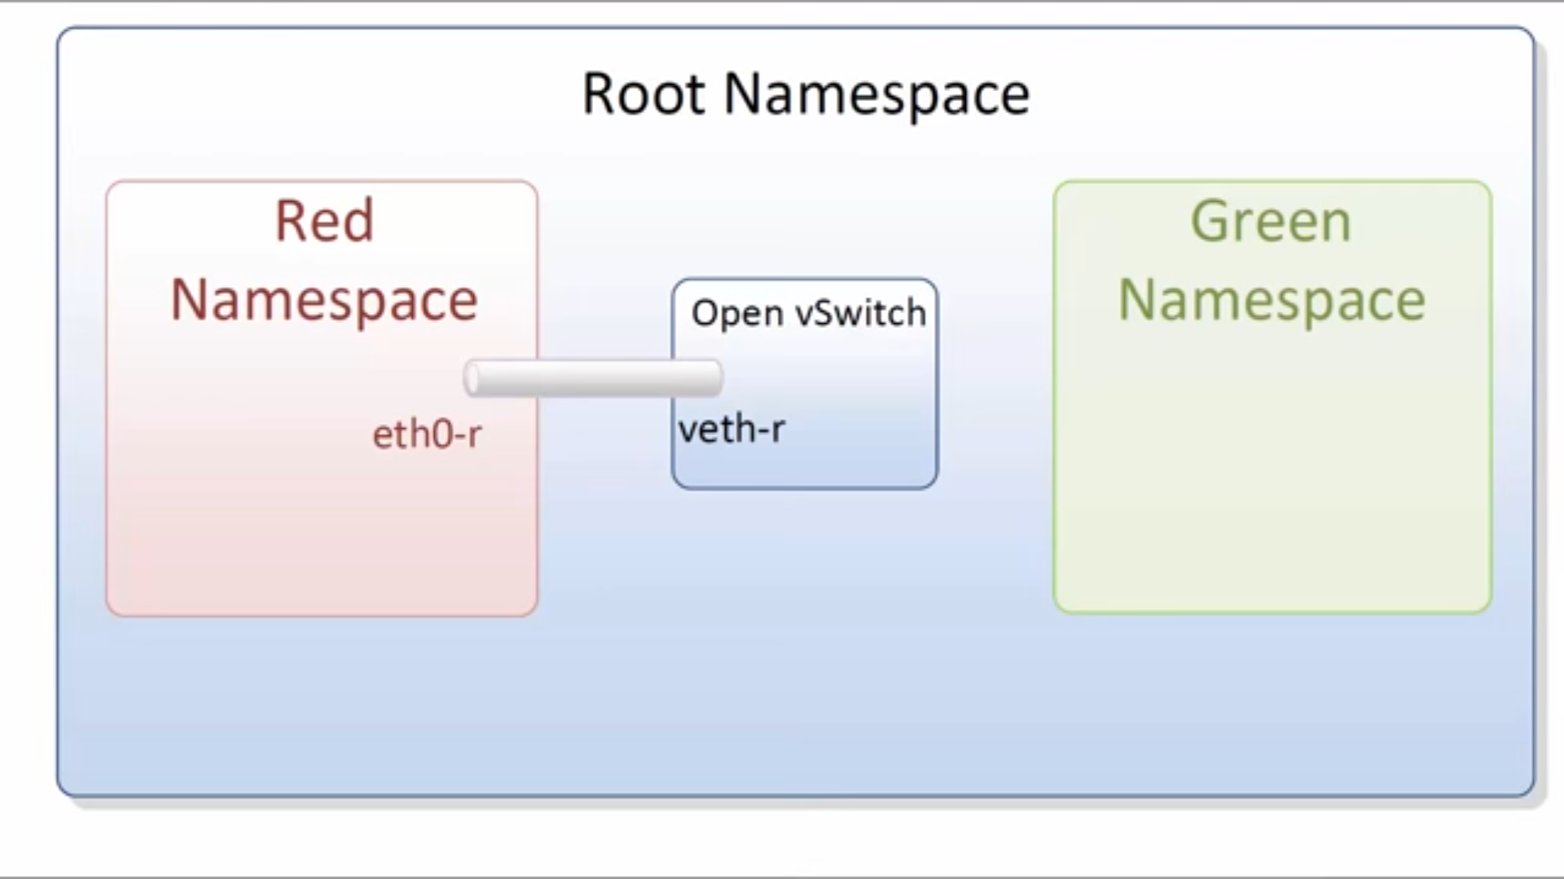

Slide 13
THAT SAME WE HAVE TO DONE WITH GREEN NS AND OVS1 BRIDGE
ALL CMD TOGETHER
# ip link add eth0-r type veth peer name veth-r => create a pip one end name eth0-r second end name veth-r
# ip link set eth0-r netns red => attach one end to NS RED
# brctl addif OVS1 veth-r => add veth-r to OVS1 bridge
# ip a => now we can’t se eth0-r
# ip netns exec red ip a => check interface added in NS red or not
# brctl show => check added or not
#ip link set veth-r up => to up veth-r

